Slide 1

Trees and Adaboost
MODULE – 6

Slide 2
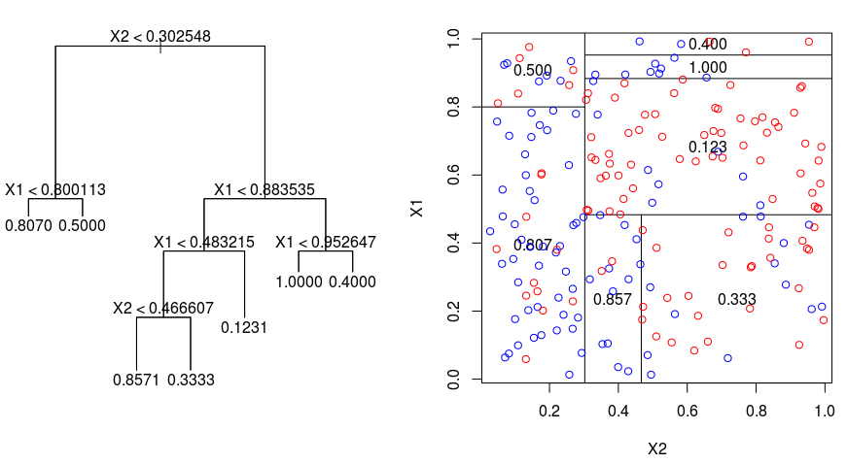
Trees
Divide feature space/tree into a set of rectangles/nodes using binary splits.
For computational reasons, we proceed greedily.
Train simple models (usually just constants) for each rectangle/leaf.
Estimate value of new case by finding appropriate rectangle/leaf and using appropriate model.

Slide 3
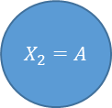
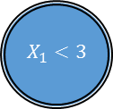
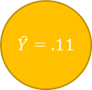
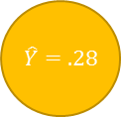
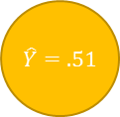
Trees
Mixed continuous & discrete features
$$X_{1}<3$$
Root
False
True
Decision
$$X_{2}=A$$
$$\hat{Y}=.51$$
Leaf
False
True
$$\hat{Y}=.11$$
$$\hat{Y}=.28$$
Figure 1

Slide 4
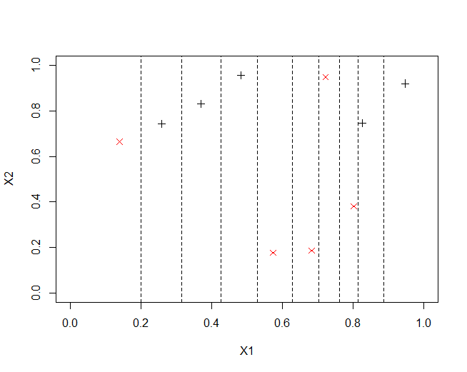
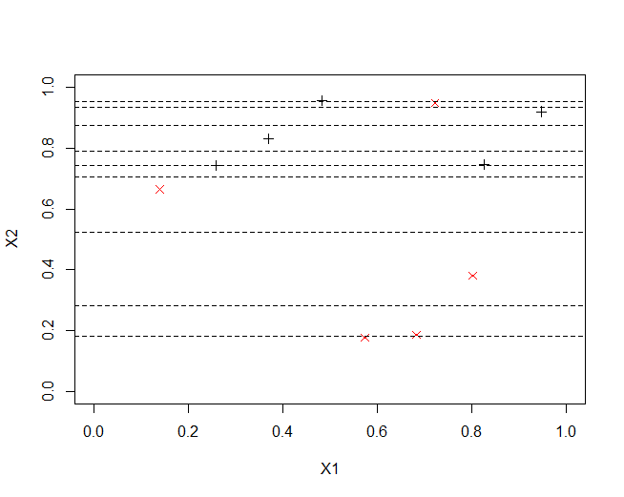
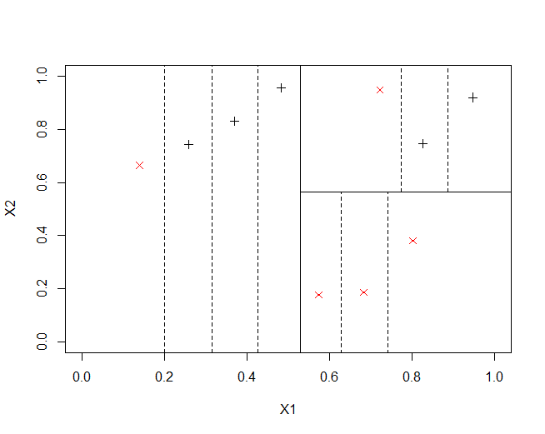
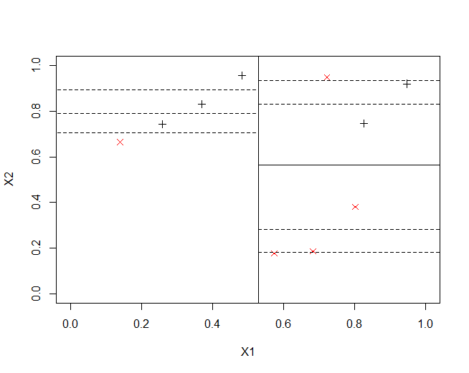
Trees
Efficient examinations of splits
Figure 9
Figure 8
Figure 6
Figure 7

Slide 5

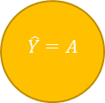
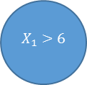

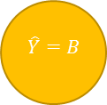
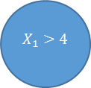
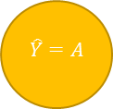

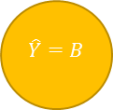
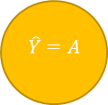
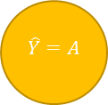
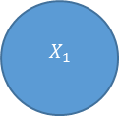
Trees
Binary splits without loss of power
$$X_{1}$$
$$X_{1}>4$$
$$X_{1}≤4$$
$${6<X}_{1}$$
False
True
$${4<X}_{1}≤6$$
$$\hat{Y}=A$$
$$X_{1}>6$$
$$\hat{Y}=A$$
$$\hat{Y}=B$$
$$\hat{Y}=A$$
False
False
True
Figure 5
$$\hat{Y}=B$$
$$\hat{Y}=A$$
Figure 4

Slide 6
Trees
Grow
Greedily add best splits
Regression: MSE
Classification: MCE, Gini-Index or Cross-Entropy (purity)
Prune
Examine potential collapses and cross-validate

Slide 7
Ensembles
Instead of one single best model combine multiple models
Voting, weighted average, …
Higher computational cost
Aim for models that are complimentary, make different mistakes
Main Techniques
Bootstrapped Aggregation or Bagging: train the same model independently on different subsets (bootstrap samples) of the data
Boosting: iteratively train a model on re-weighted versions of the data set where the ‘hard’ samples have a higher weight
Stacking: use a new model (often logistic regression) to combine predictions of existing models

Slide 8
Tree Bagging
Create a set of trees, each trained from a bootstrap sample of the data.
Bootstrap samples are samples, generally the same size as the original data, drawn from the original data with replacement.
Output the mode (classification) or mean (regression) of all trees.
Tree bagging improves accuracy by reducing the variance of the model, while not affecting its bias.

Slide 9
Random Forests
As tree bagging, but each tree is generated from a bootstrap sample using a randomly selected subset of input variables.
Each tree in the forest is a product of multiple randomness:
The data involved (bootstrap sampling)
The variables used for the modelling
Using only randomly selected subsets of variables at each growth step for each tree reduces the correlation between trees in the forest. This further reduces the variance of the model while still not effecting the bias.

Slide 10
Random Forests
Perform very well.
Do not (strongly) overfit with large numbers of tree.
Important to optimize the number of features involved at each growth step.
Also permit simple variable importance measure: the average increase in score (is misclassification or other) when a variable is involved in splits.
Out-of-sample performance evaluation allows unbiased estimate of performance on training data.
I’m a big fan ☺.

Slide 11
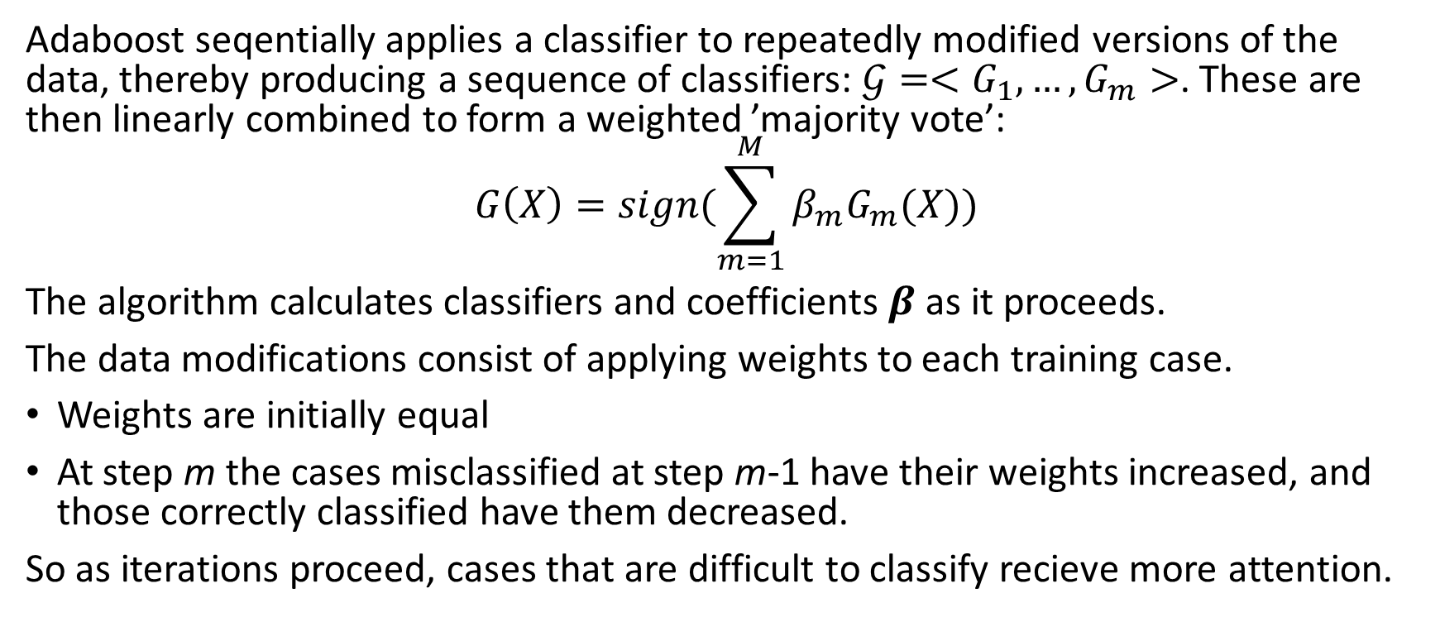
Adaboost
Adaboost seqentially applies a classifier to repeatedly modified versions of the data, thereby producing a sequence of classifiers: $𝒢=<G_{1},…,G_{m}>$. These are then linearly combined to form a weighted ’majority vote’:
$$G\left(X\right)=sign(\sum_{m=1}^{M}{β_{m}G_{m}(X)})$$
The algorithm calculates classifiers and coefficients $β$ as it proceeds.
The data modifications consist of applying weights to each training case.
Weights are initially equal
At step m the cases misclassified at step m-1 have their weights increased, and those correctly classified have them decreased.
So as iterations proceed, cases that are difficult to classify recieve more attention.

Slide 12
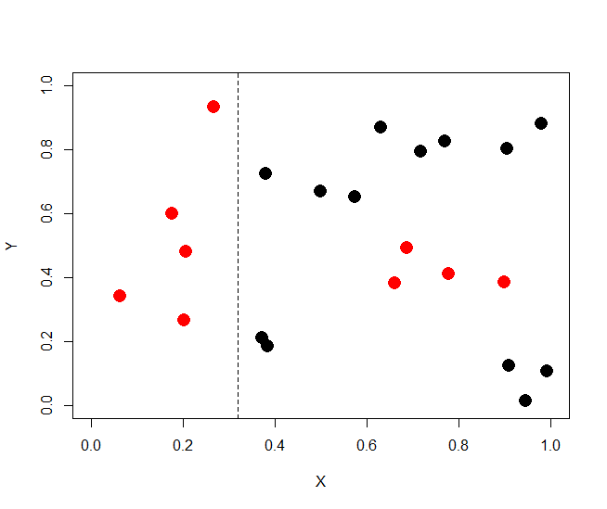
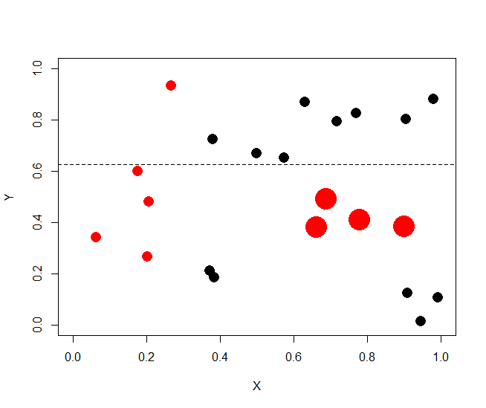
Adaboost
Visual example of reweighting data in subsequent 'root' tree.
Figure 23

Slide 13
Adaboost ”the best off the shelf classifier in the world” Leo Breiman
Adaboost
Used with ’weak’ classifiers.
Can yeild astonishing performance improvements.
Regression boosting techniques also perform well (see gbm package)

Slide 14
Adaboost with Trees
Normal implementation of adaboost
Generally also uses bootstrap samples and a randomly selected subset of variables (though check your package documentation).
In this case, the variance is minimized as in a random forest, but the boosting aspect of the algorithm also reduces the bias.
Important to estimate number of trees to use

Slide 15
Implementations
randomForest package
randomForest function
mtry – number of features examined for new splits
tuneRF – automatically optimizes mtry
ada package
ada function
n.iter – The number of trees
Examine output for best number of trees and pass to predict
See more information in EDSA module

Slide 16
Random Forests and Adaboost with Trees: Exercises
Plot 2d and 3d random forest regression models.
Create random forest models for the regression tasks you have previously performed. Do this with and without tuneRF.
Create random forest and adaboost models for the classification tasks you have previously performed. Remember to evaluate the number of trees to use in the adaboost case.
For (2) and (3), compare performance between these new models and models you have previously created for these tasks.

